Slide 1

Geonovum
Workshop 3D Tiles
Pieter Bresters, Rolf Jonker

Slide 2
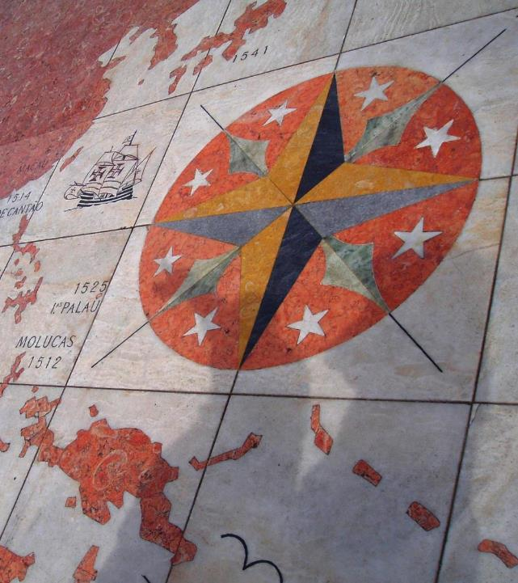

Agenda
Introduction
Theory: Fundamentals of 3D Tiles
Hands-on: Creating 3D Tiles
  Lunch
Hands-on: Creating 3D Tiles (1.0 and 1.1)
Hands-on: Styling 3D Tiles (1.0 and 1.1)
Hands-on: Converting your own data (bonus assignment)
Wrap-up and closing
Tiles in the floor of the monument of discovery in Lisbon, Portugal.
(Lee Cannon April 2010, CC-BY-SA,
https://www.flickr.com/photos/leecannon/5127274297)

Slide 3

Introductions
Who are you?
What brings you here today?
What is something you recently got excited about?

Slide 4
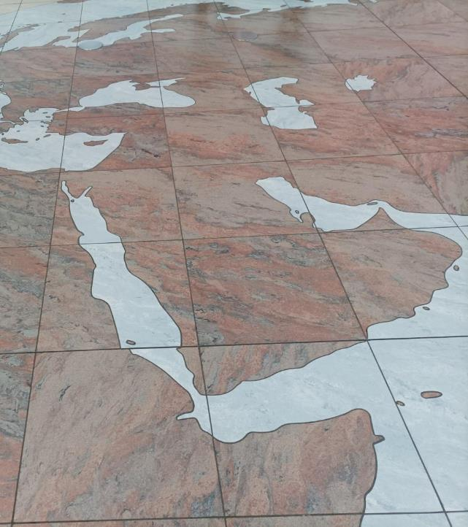
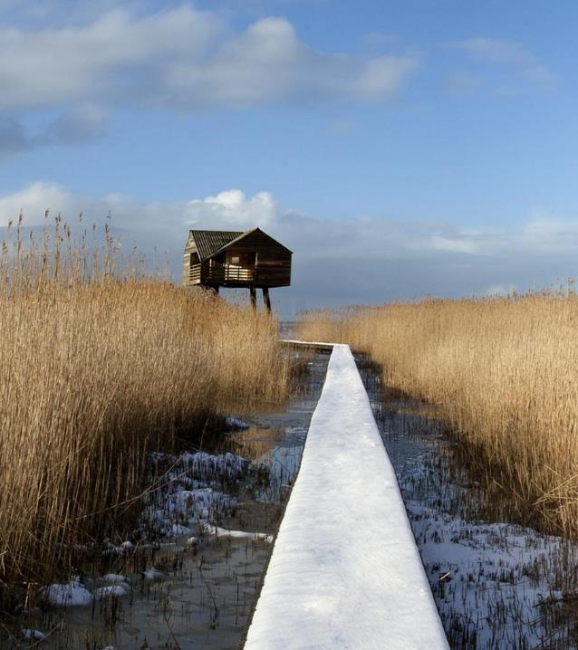
Requirements
Laptop with an internet connection and admin rights
Docker account (running locally)
QGIS 3.40 or higher
Database management tool (pgAdmin or DBeaver) (1.0)
Tiles in the floor of the terminal 2 of the Prague Airport, Czech Republic. (Joan Masó, September 2022, CC0)

Slide 5
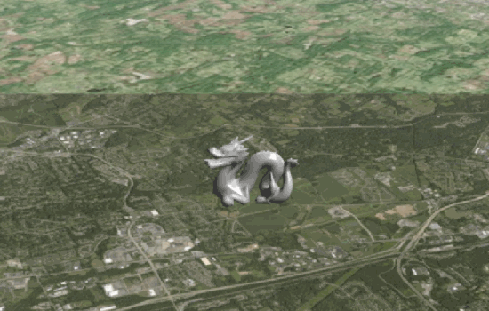
Theory: Fundamentals of OGC 3D Tiles
Source: Cesium 3D Tiles samples

Slide 6
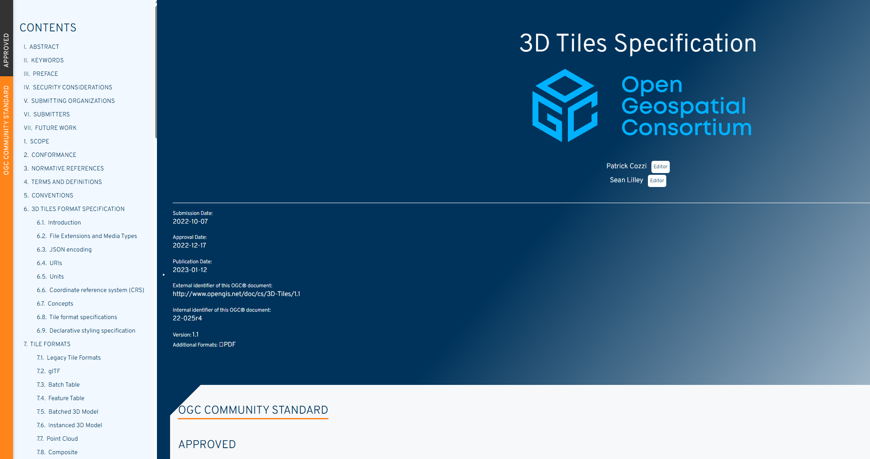
Why OGC 3D Tiles?
https://docs.ogc.org/cs/22-025r4/22-025r4.html

Slide 7
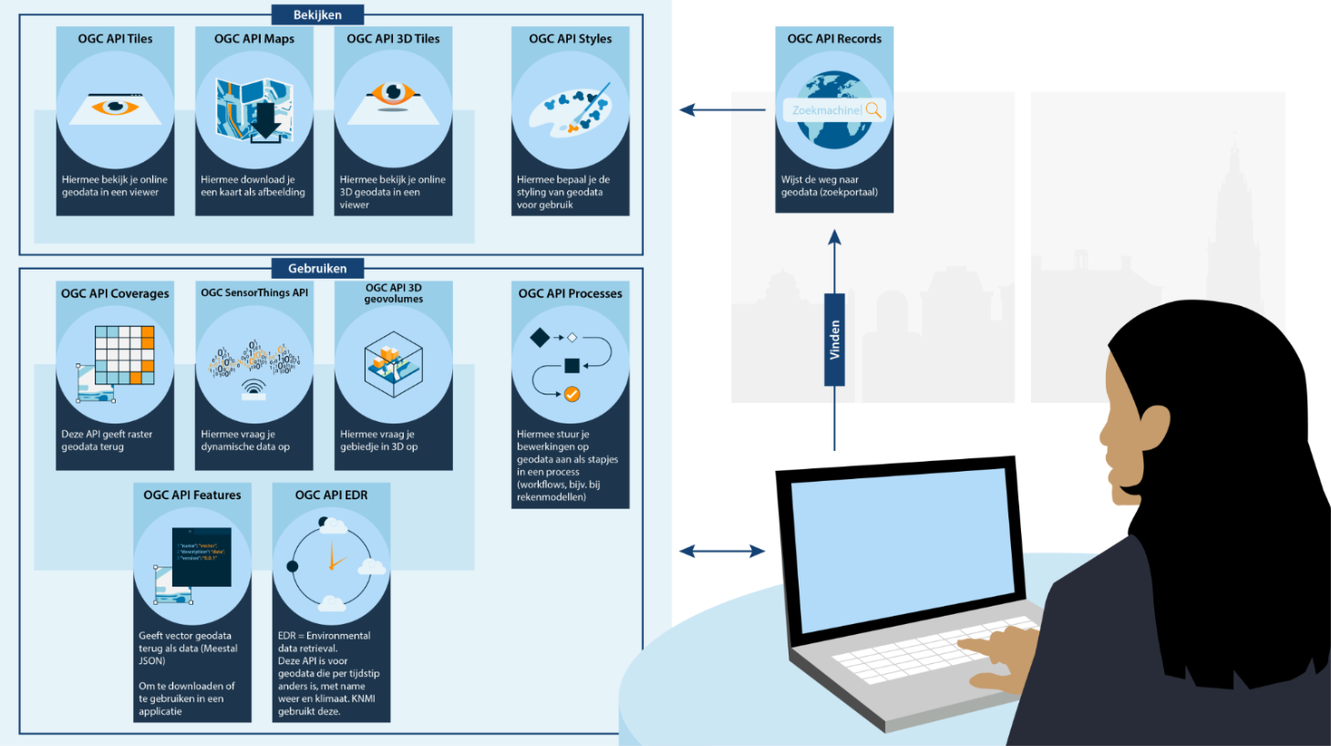
Why OGC 3D Tiles?

Slide 8
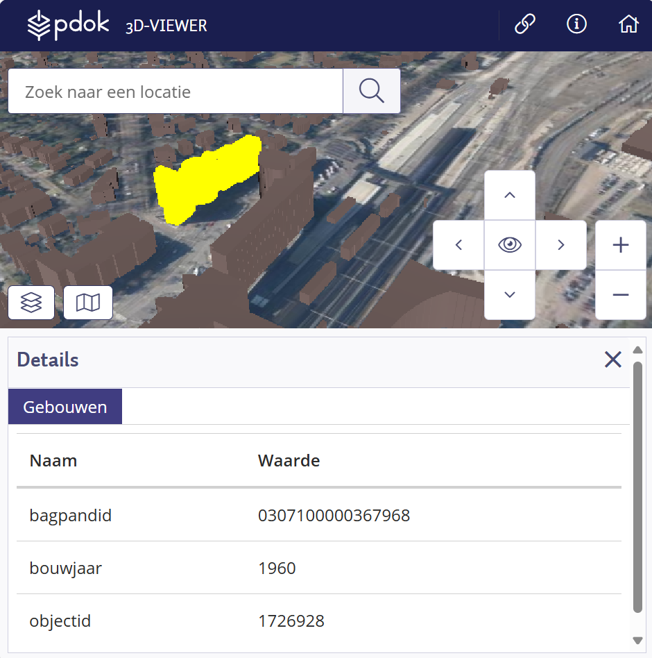
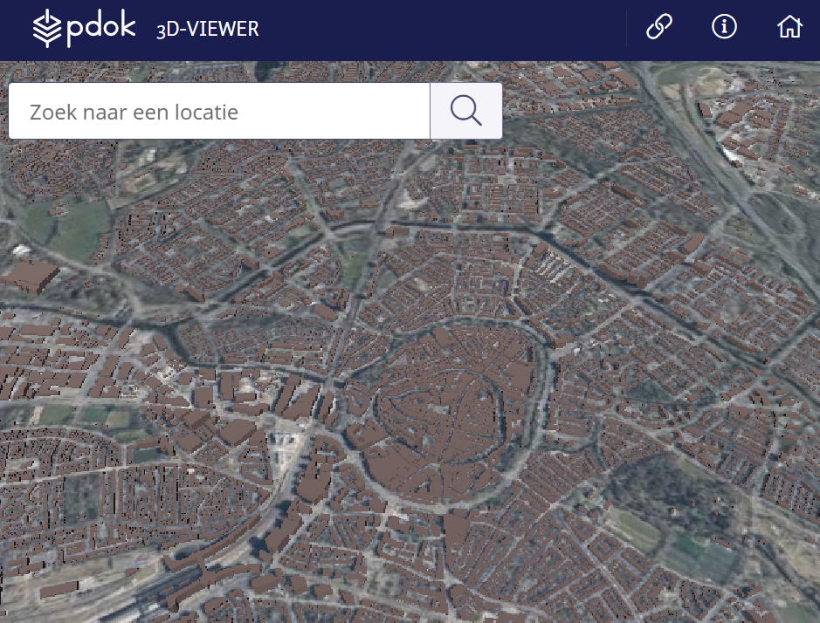
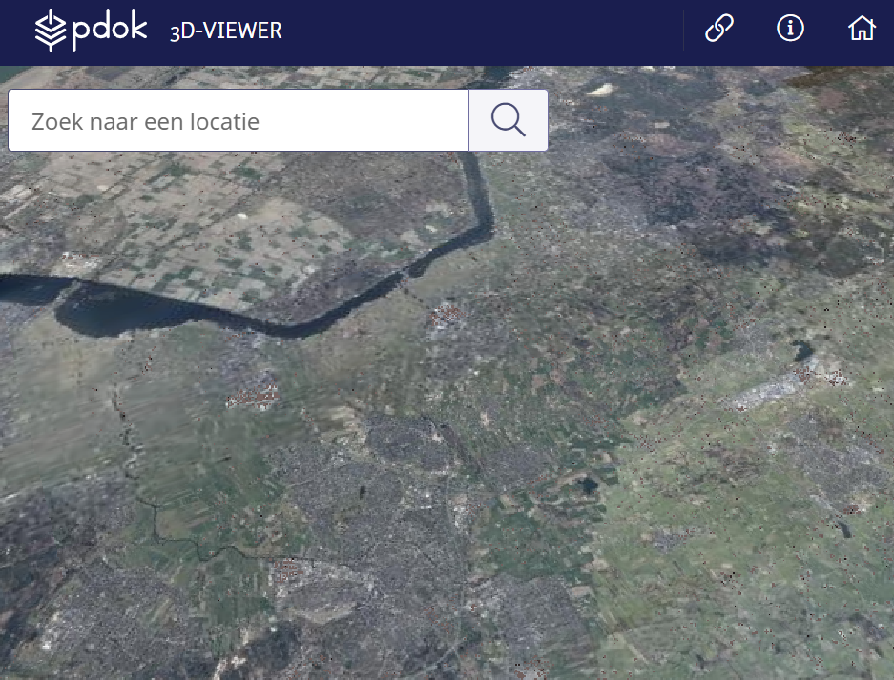
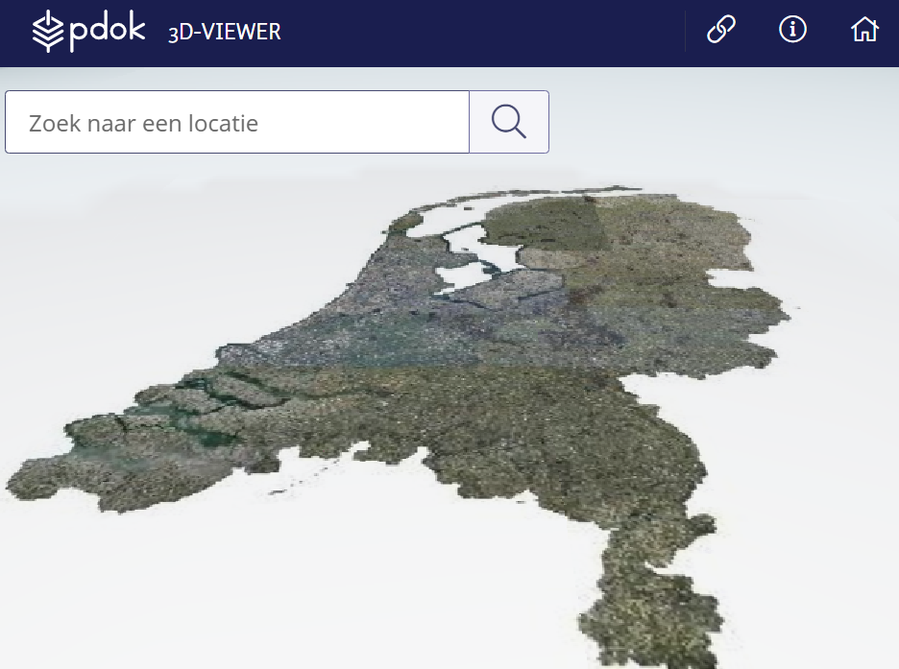
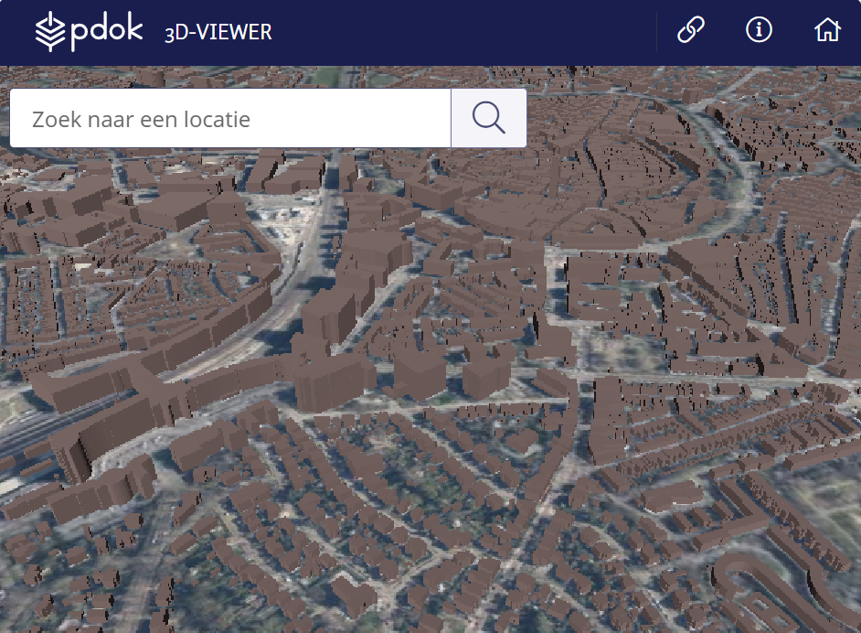
Why 3D Tiles?
Notes:
Very fast loading of exactly the content that is needed. Depending on position and zoom level, different data is loaded. Attributes can be linked.

Slide 9
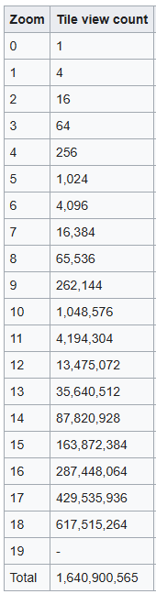
Why 3D Tiles?
How many buildings are there in the 3D BAG?
+/- 11 million buildings
+/- 2 billion faces (estimate)
How much data do you download for the entire 3D BAG?
18 GB (.zip)
Source: https://3dbag.nl/en/download
Notes:
It is a visualization standard. It prevents a client from having to download large amounts of data. Fun to do as a quiz.

Slide 10

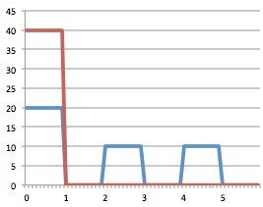
Why 3D Tiles?

Slide 11
How does OGC 3D Tiles work?

Slide 12
How does 3D work in a computer?
What happens between your 3D data and the image on the screen?
Notes:
www.artofit.org An intro to modern OpenGL. Chapter 1: The Graphics Pipeline

Slide 13
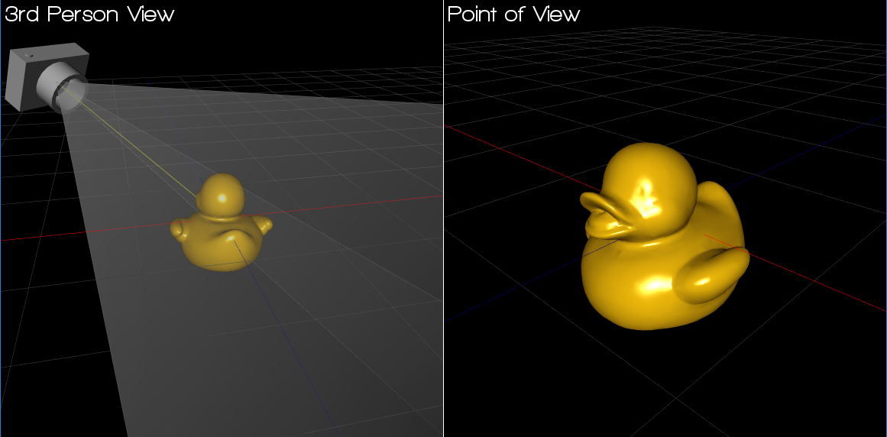
How does 3D work in a computer?
The camera sees part of a 3D world. Rendering converts the field of view into pixels.
Buildings, terrain, trees,…
The goal of visualization is to convert 3D coordinates into 2D pixels.
Only what the camera sees is drawn.
Image: songho.ca
Notes:
www.artofit.org An intro to modern OpenGL. Chapter 1: The Graphics Pipeline

Slide 14
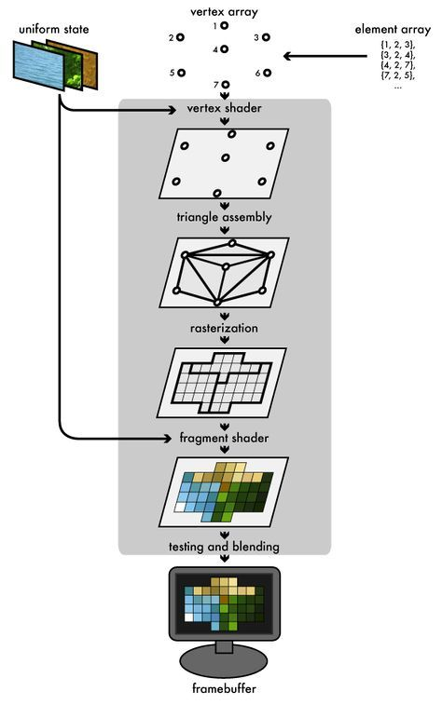
The graphics pipeline
A simplified model, from vertices to pixels.
01
Geometry
vertices
02
Model / world
position
03
View
camera
04
Projection
3D to 2D
05
Rasterization
Triangles to fragments
06
Shading
Color and light
→
→
→
→
→
Transformations (1 – 4) compute the screen position of each vertex.
Rasterization determines which samples (pixels) fall inside a triangle.
www.artofit.org
Notes:
www.artofit.org An intro to modern OpenGL. Chapter 1: The Graphics Pipeline

Slide 15
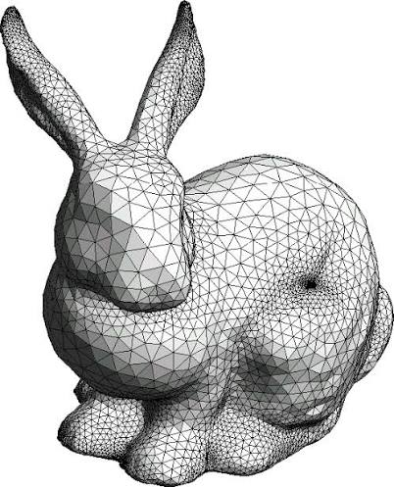
The world of triangles
A triangle is always a single flat plane
GPUs rasterize triangles efficiently
Colors, UVs and normals are interpolated
Complex surfaces are stored as a network of triangles (‘mesh’).
3D Tiles feeds such meshes into the pipeline
Image: Stanford Bunny
Notes:
A triangle is always flat (planar):
Three points in space always define exactly one flat plane. This prevents a surface from bending or warping, which keeps the math for calculating shadows and lighting consistent and simple.
GPUs rasterize triangles efficiently: graphics cards are designed in hardware to convert triangles from 3D coordinates into 2D pixels on your screen at high speed (rasterization). This process runs in parallel, so modern GPUs can process billions of triangles per second.
Colors, UVs and normals are interpolated: you don't need to store data for every pixel. The GPU automatically calculates the values between the three corner points (vertices) using linear interpolation, which produces smooth color transitions, texture placement (UV) and realistic lighting
(normals).
Complex surfaces are stored as triangle meshes: just as a digital image is made up of pixels, every complex 3D object (Stanford bunny) is made up of a network of connected triangles, a so-called 'mesh'.

Slide 16
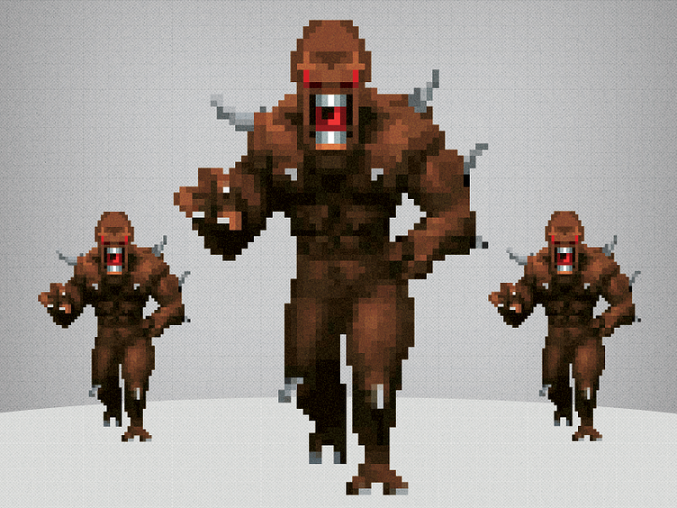
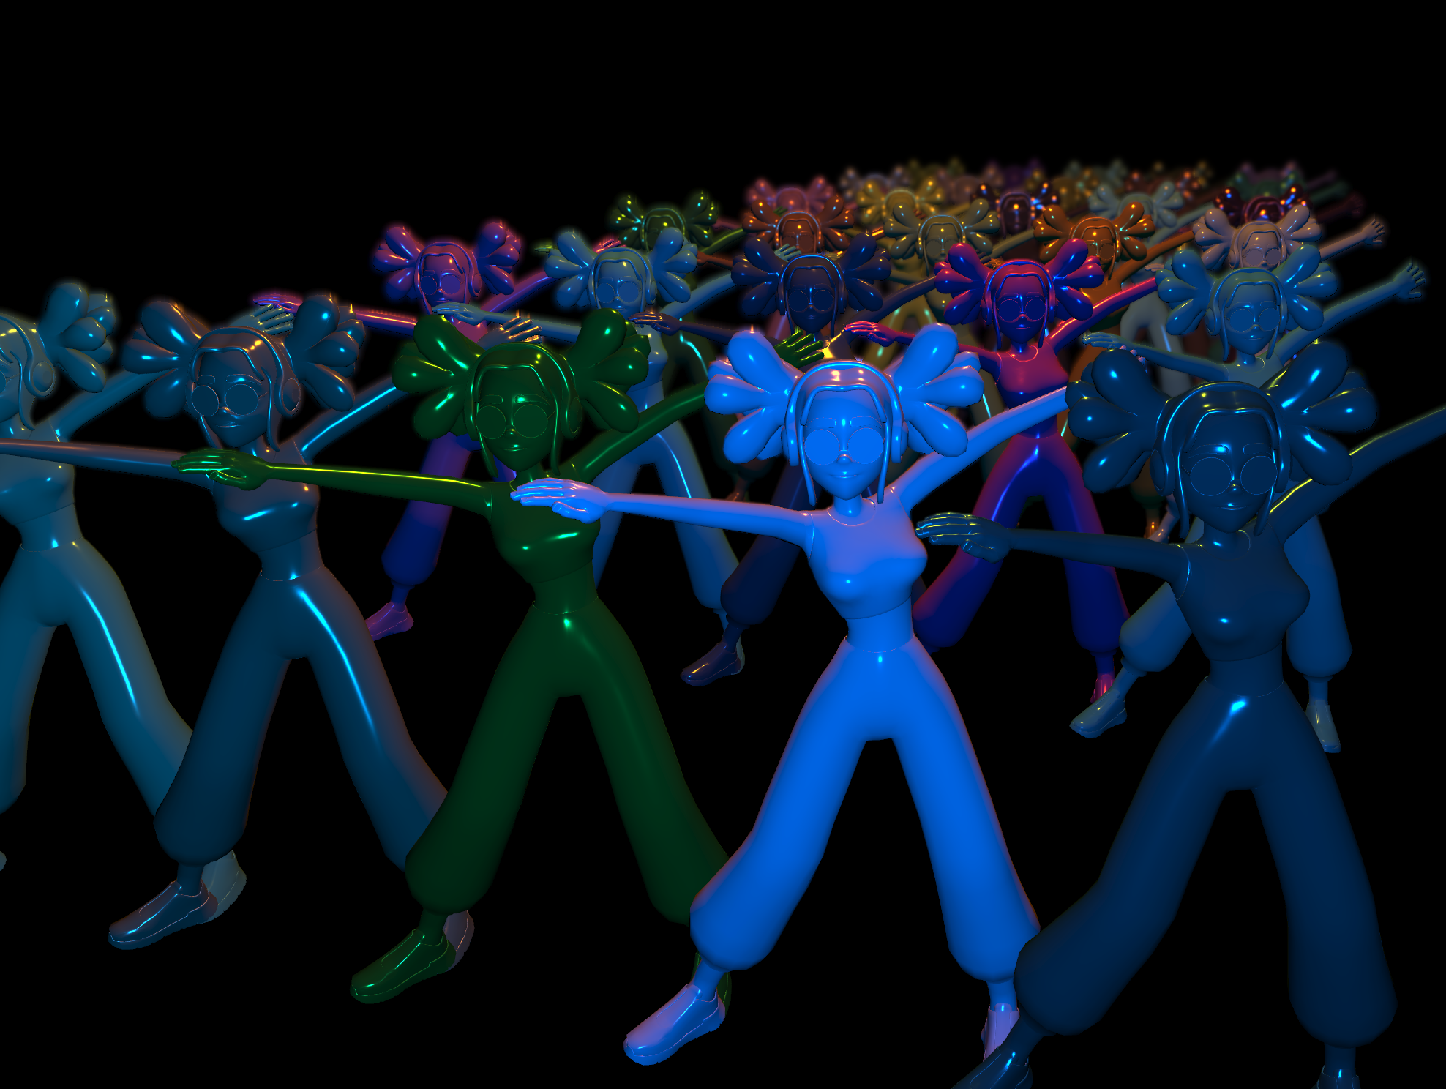

Relevance for 3D Tiles
A lot of detail does not automatically mean a lot of geometry.
Billboard
Instancing
Shaders
Image: threejs
Image: threejs
Image: Doom
Per-vertex and per-pixel work. The GPU computes material and colour.
A plane that turns to face the camera
Same geometry model, drawn many times

Slide 17
Billions of triangles
What if a city has billions of triangles? 3D Tiles organizes and streams data before it enters the graphics pipeline.
1
Camera
Position and view
2
Select
Visible tiles
3
Refine and add
LOD and error
4
Load
stream and decode
5
GPU
geometry and texture
6
Render
pixels
→
→
→
→
→
3D Tiles = spatial hierarchy + view-dependent selection + streaming
Graphics pipeline = transforms + rasterization + shading
In a demo: zoom in and you see extra detail (refine or add), rotate and you see culling (leaving out geometry you cannot see), inspect and you see the tile hierarchy and bounding volumes.
Notes:
Culling means discarding geometry early in the pipeline that would not be visible anyway. That saves work: what you don't draw costs no computing time. It is also described as filtering out or pruning.
The main types:
Backface culling Triangles whose back side faces the camera – GPU, after transformation
View frustum culling Objects outside the field of view (the view pyramid) – CPU/engine, before drawing
Occlusion culling Objects hidden behind other objects – engine/GPU
Clipping (related) Triangles that are partly out of view are cut off – GPU, before rasterization
Scenegraph (
Camera (orthographic, stereo, perspective)
3D objects (buildings etc.)
Instancing vs
Textures (material)
Relief (bump map)
Color
Reflection
Lights
Motion or animation

Slide 18
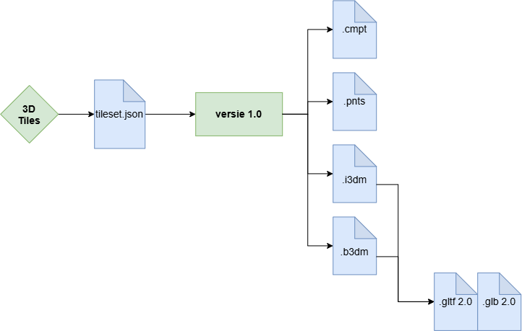
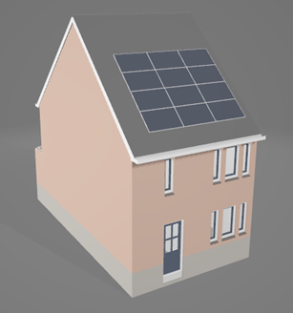
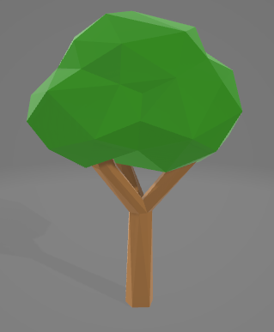
How does OGC 3D Tiles (1.0) work?
Trees.i3dm
places 5 trees at these coordinates (rotation, scale)
Tileset.json
If the camera is at this point with this viewing direction: load 0_0_0.i3dm
Tree.gltf
Is the 3D model of a tree, with a trunk, branches, crown and color
Notes:
.cmpt (Composite) is a container that bundles several tiles of the formats above into one file, for example a b3dm with buildings plus an i3dm with trees for the same area. That way only one request per tile is needed instead of several.
.pnts (Point Cloud) is for point clouds, such as AHN lidar or scans. For each point the position and optionally color, normal and attributes are stored. It contains no glTF; the points are rendered directly from binary buffers.
.i3dm (Instanced 3D Model) is for many copies of the same model: trees, street lights, wind turbines, benches. The model (glTF) is stored once and the Feature Table gives the position, rotation and scale of each instance.
.b3dm (Batched 3D Model) is for heterogeneous 3D models such as buildings, BIM objects, textured meshes and photogrammetry. The file contains a glTF model, supplemented with a Feature Table and a Batch Table. This lets many objects be rendered together in one draw call while each object remains individually selectable, with its own attributes (for example a batchId per building with a BAG ID or an IFC class).

Slide 19
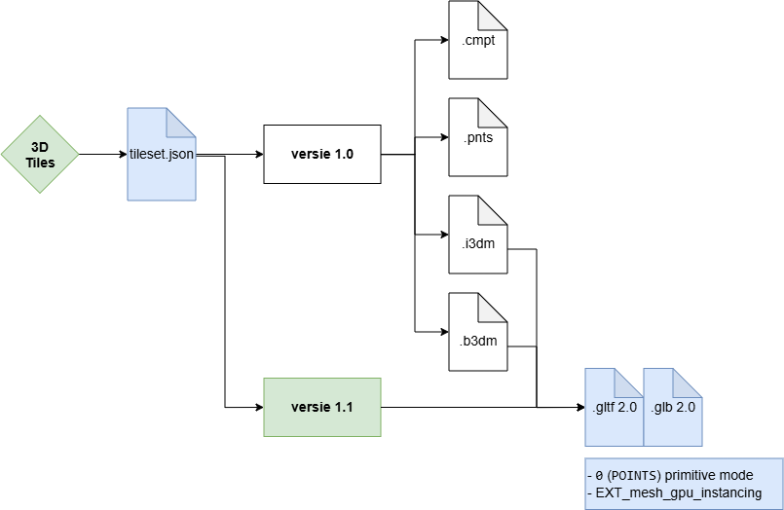
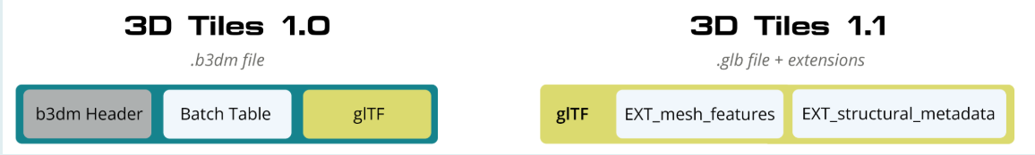
How does OGC 3D Tiles (1.1) work?
Tileset.json
If the camera is at this point with this viewing direction: load 0_0_0.gltf
Tree.glb
Is the 3D model of a tree, with a trunk, branches, crown and color
EXT_mesh_gpu_instancing
places 5 trees at these coordinates, with rotation and scale
Notes:
The special 3D Tiles containers disappear and their functionality moves to glTF extensions.

Slide 20
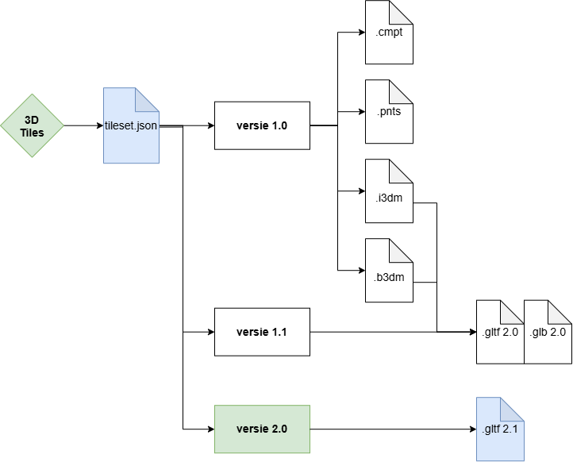
How does OGC 3D Tiles (2.0) work?

Slide 21
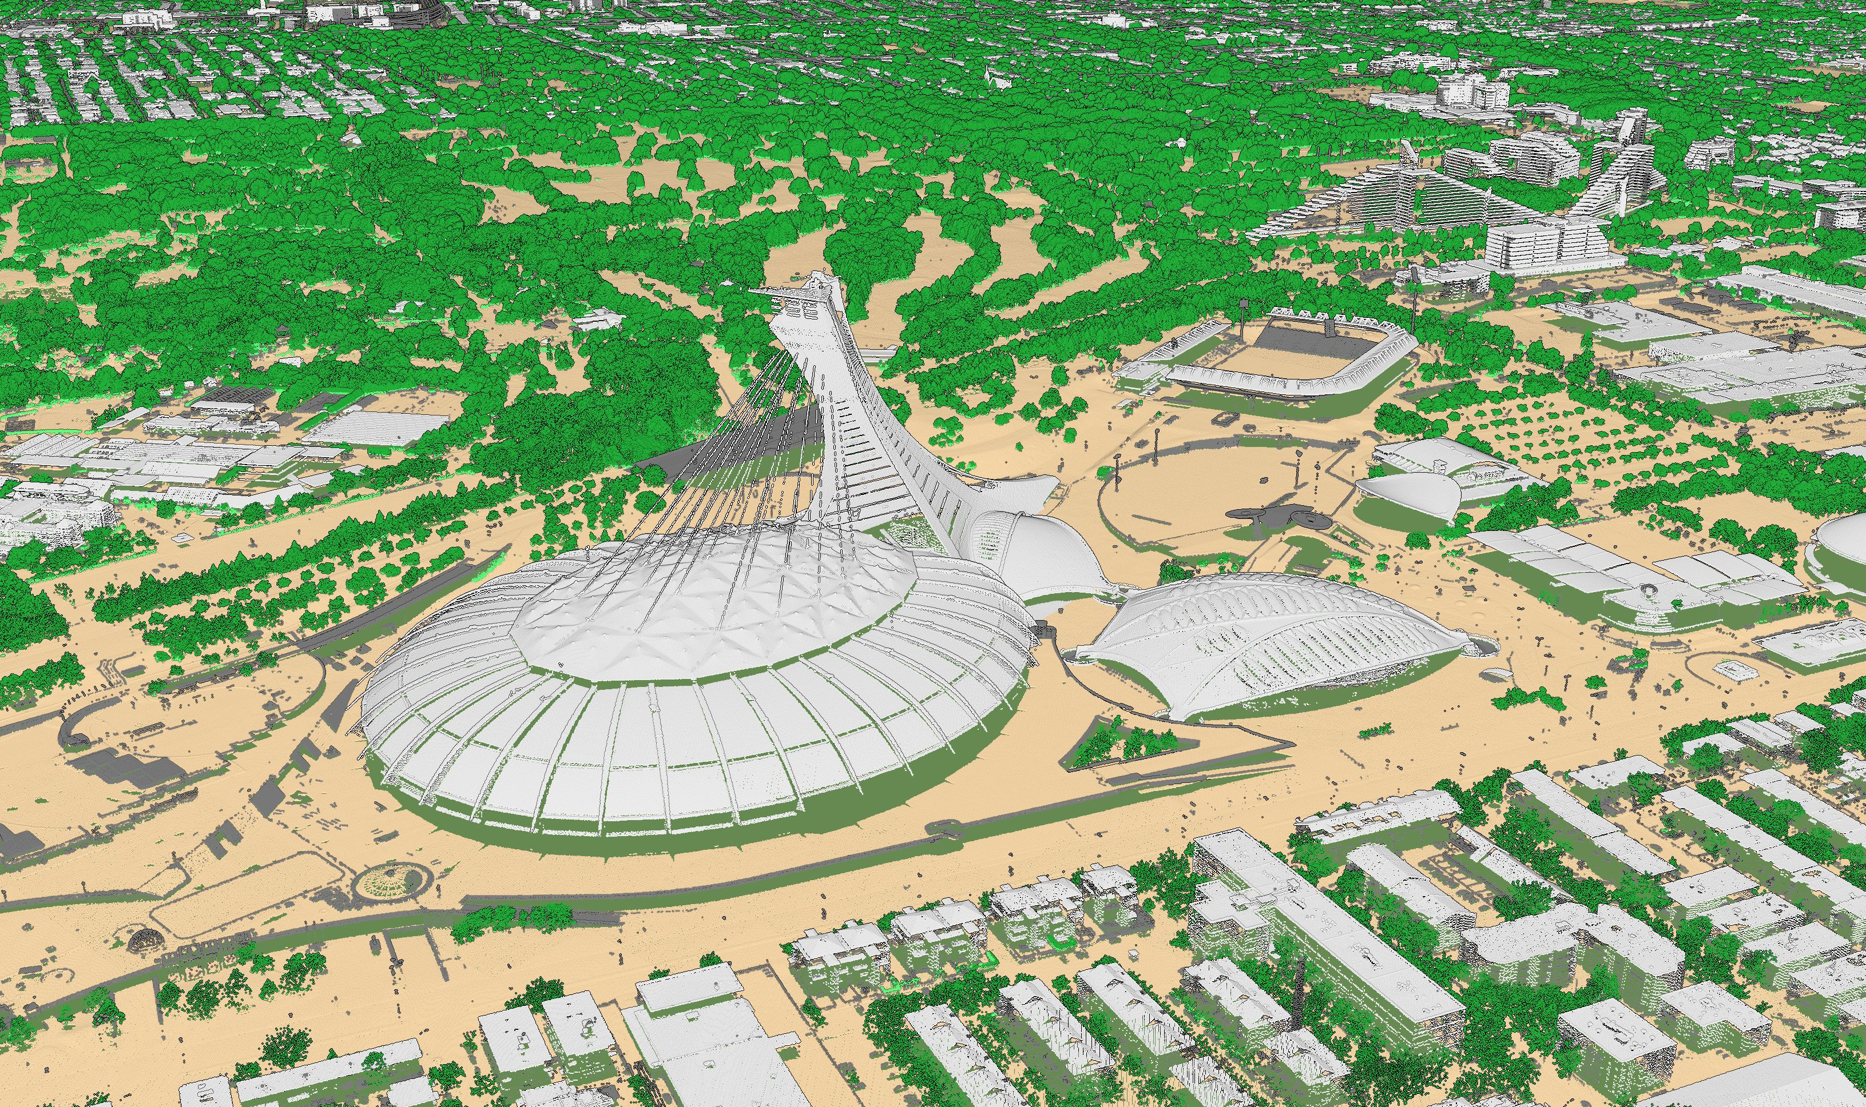
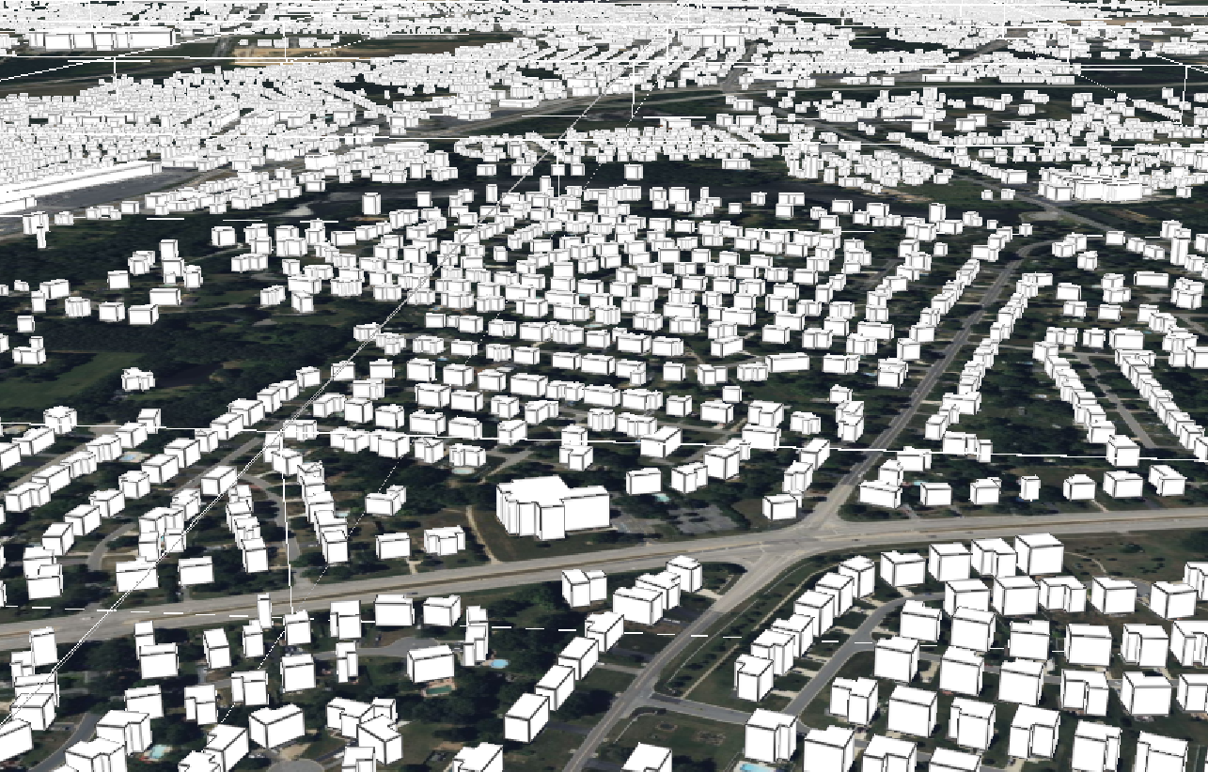
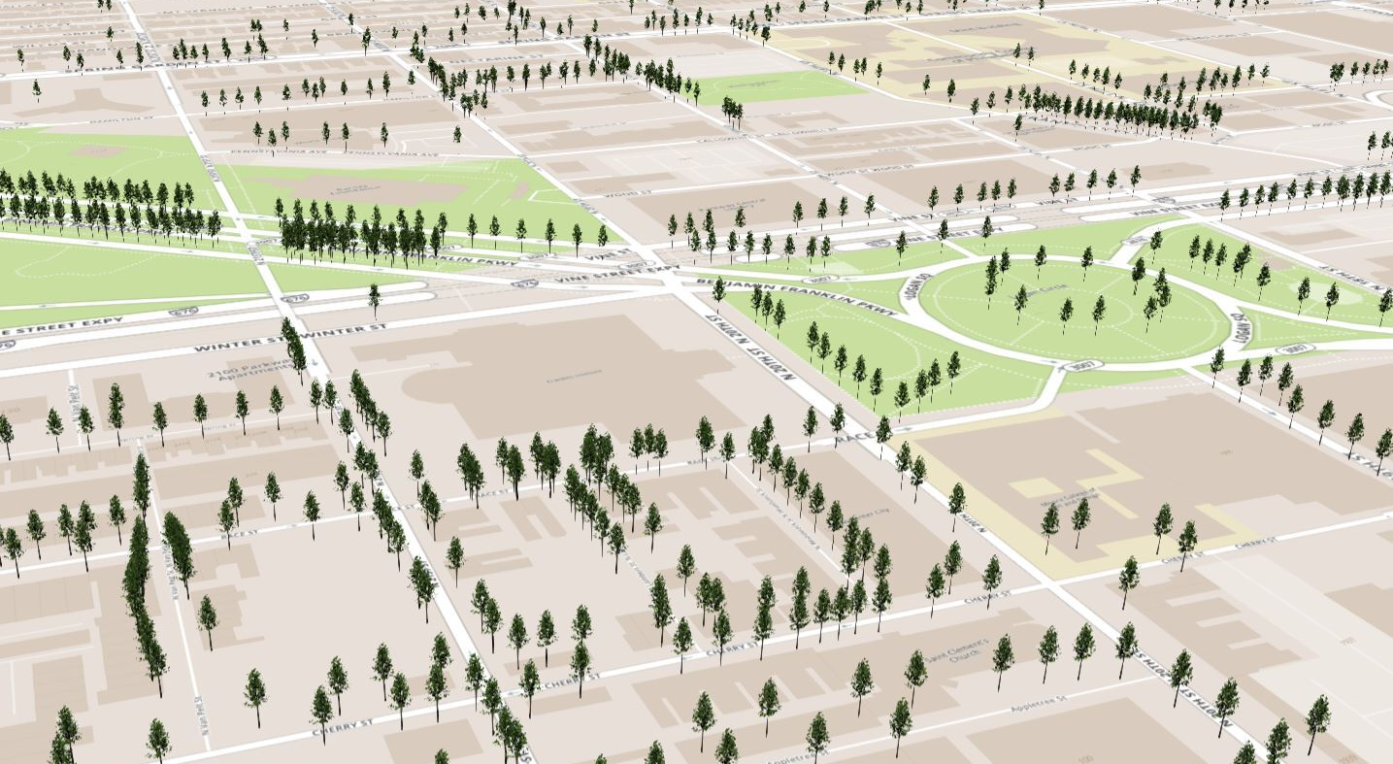
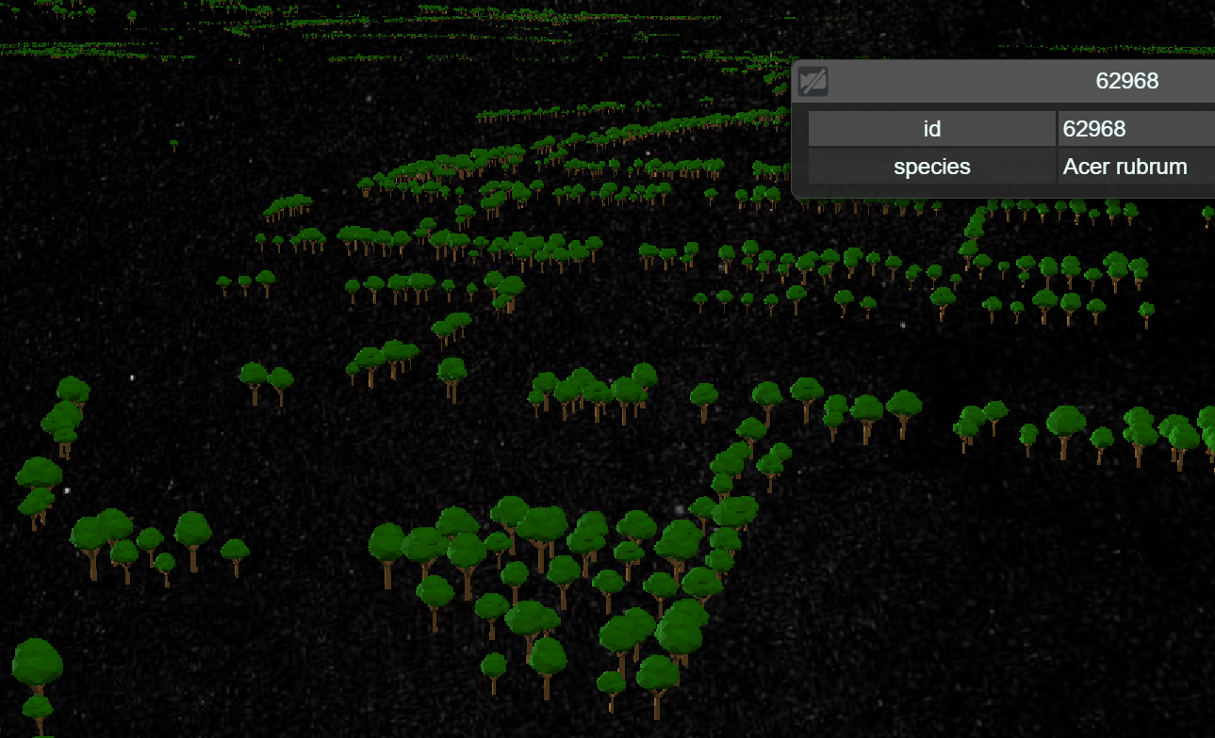
Content types in OGC 3D Tiles 1.0 and 1.1
Pointclouds
Single 3D model
.pnts / .gltf/.glb
.b3dm / .gltf/ .glb
Instances
Composites
.i3dm / .gltf/.glb
.cmpt / .gltf/ .glb

Slide 22
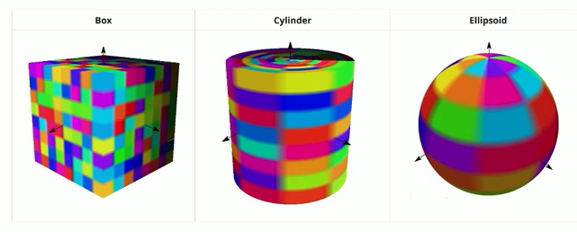
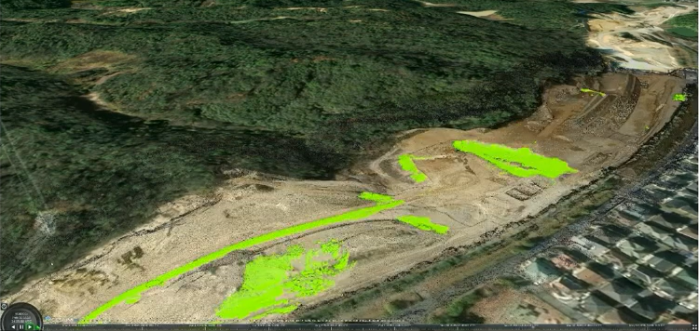
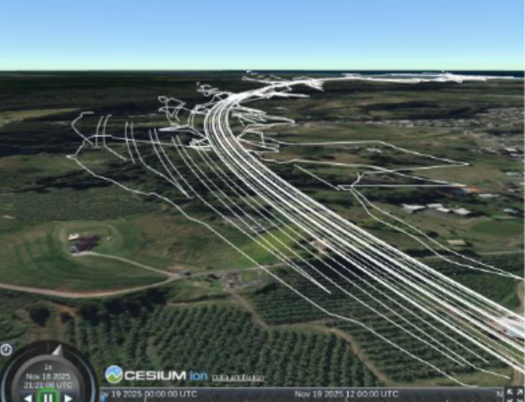
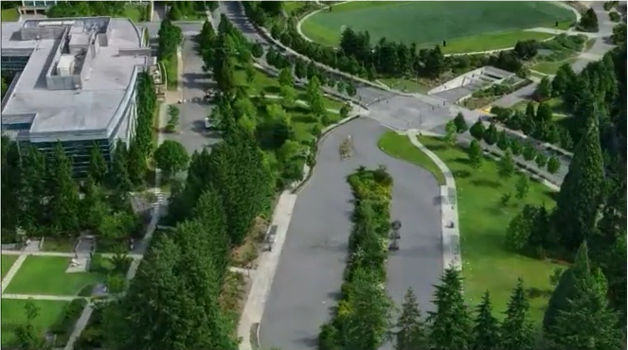
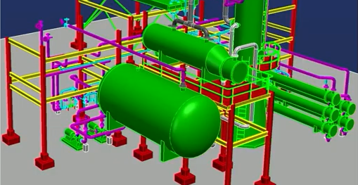
Additional content types in OGC 3D Tiles 2.0
Voxel
Time-dynamic
Vector tiles
Gaussian Splats
.gltf/.glb
AEC
.gltf/.glb
.gltf/.glb
What's New in 3D Tiles
.gltf/.glb
.gltf/.glb

Slide 23
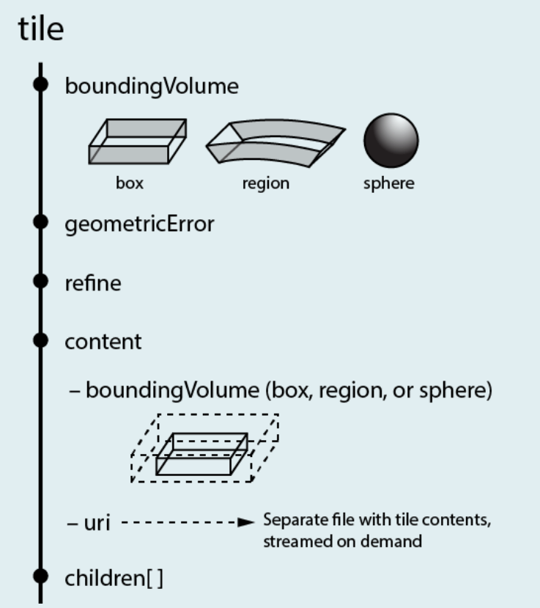
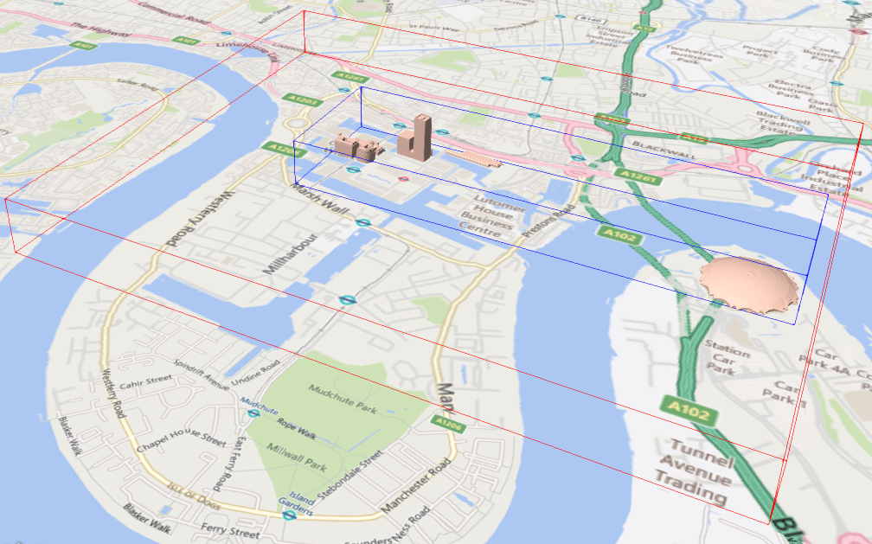
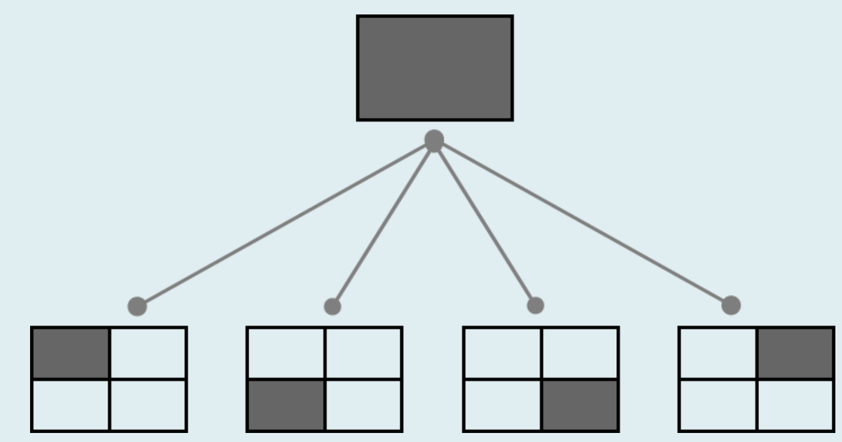
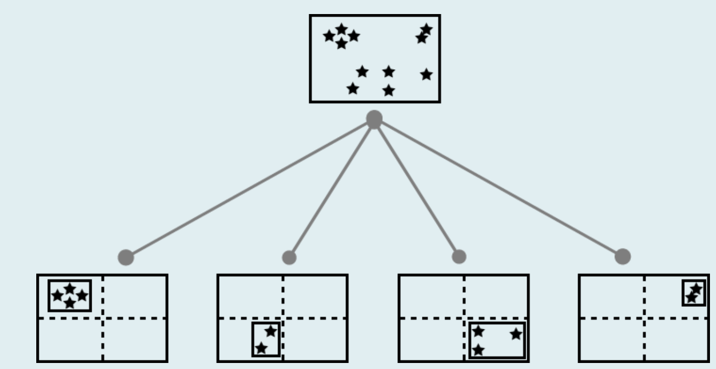
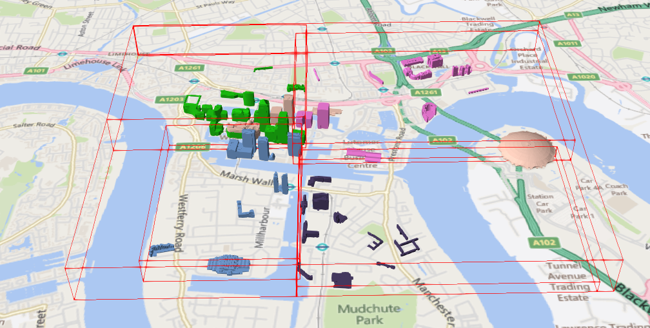
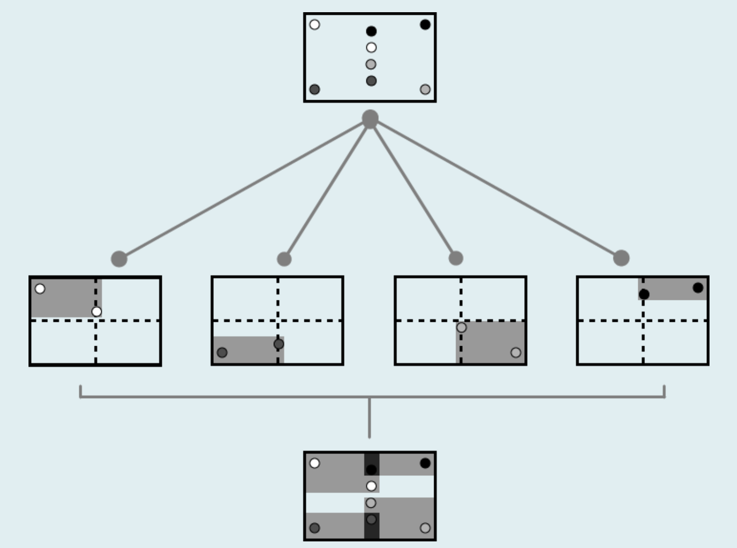
How is the tileset.json structured?
  tile.boundingVolume (red) and content.boundingVolume (blue)
Notes:
Tile.boundingVolume (required) Is the boundingVolume in view and is the distance to the camera small enough? Then the content within this tile is considered as well.
content.boundingVolume (optional) Is the boundingVolume of the content in view? And is the distance to the camera small enough? Then the content is loaded too. Is this boundingVolume missing? Then the content is loaded regardless.
A tile has children. These children can be neatly subdivided, but the specification imposes no restrictions. Children may also leave gaps between them or overlap.

Slide 24
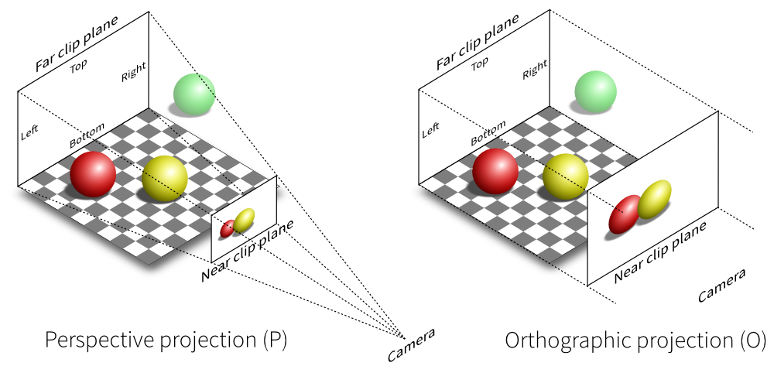
How does the geometric error work?
Geometric error
Defined in a tileset
2) Screen Space error
Calculated by the application relative to the screen. How many pixels is x meters?
3) Maximum Screen Space Error
Set automatically or configurable by the user
Notes:
The tile specifies:
The root has a large error (geometric error) (heavily simplified or little data), its children an increasingly smaller one. The tool that creates the tileset determines these numbers.
Screen Space Error and Maximum Screen Space Error are calculated and set in a tool.
The viewer translates the error in meters into pixels on the screen: how many pixels do x meters cover at that distance?
With perspective projection the number of pixels per meter depends on the distance. A tile far away has a small SSE and is shown coarsely; nearby it is refined. Each part of the image can therefore have a different level of detail: fine in the foreground, coarse at the horizon.
With orthographic projection the number of pixels per meter is the same everywhere in view. All tiles with the same geometricError get the same SSE, regardless of distance. The level of detail depends only on how far you have zoomed in (how big the box is).

Slide 25
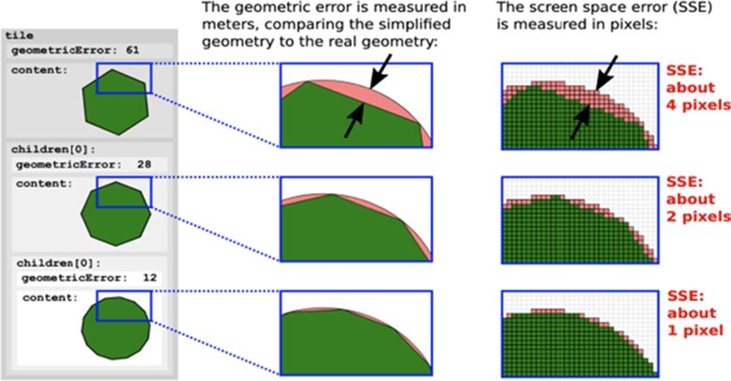
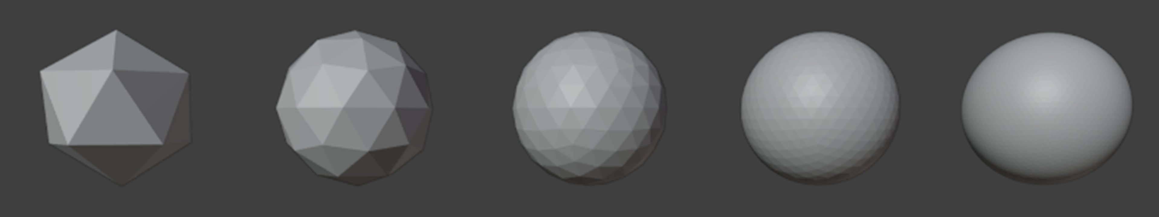
How does the geometric error work?
Geometric Error | Screen space error | Maximum screen space error | Shown?
61 | 4 | 2 | No
28 | 2 | 2 | Yes
12 | 1 | 2 | No
Source: An interoperable web-based application for 3d city modelling and analysis
Source: Cesium (selection algorithm details)
Notes:
What happens here:
A tile is defined with a geometricError of 61 meters. At the zoom level shown here, 61 meters equals “4 pixels”. A maximum screen space error of “2 pixels” is set. This makes refinement necessary.
That is possible here, because the tile also has a child with a geometric error of 28. At the current zoom level, 28 meters equals “2 pixels”. The maximum screen space error is 2 pixels, so this geometricError is sufficient. The child will be loaded.
This tile also has a child with a geometricError of 12. 12 meters equals “1 pixel”. Since the parent already suffices, this child will not be loaded.

Slide 26
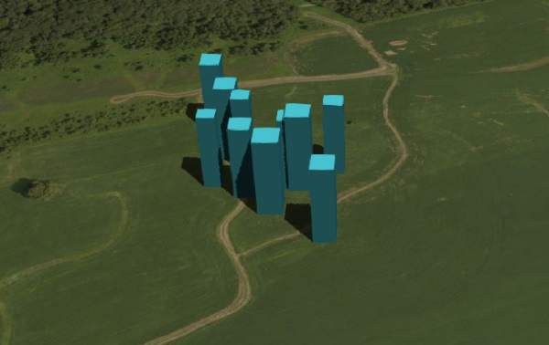
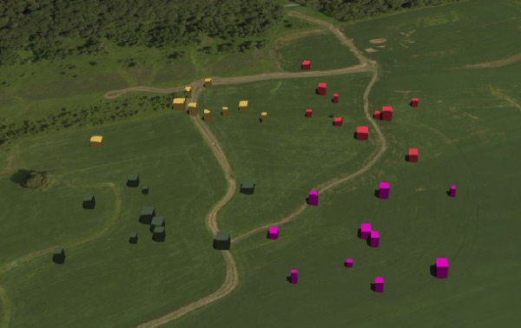
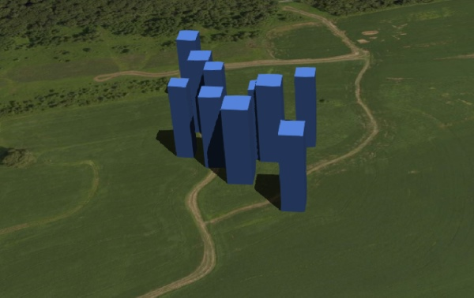
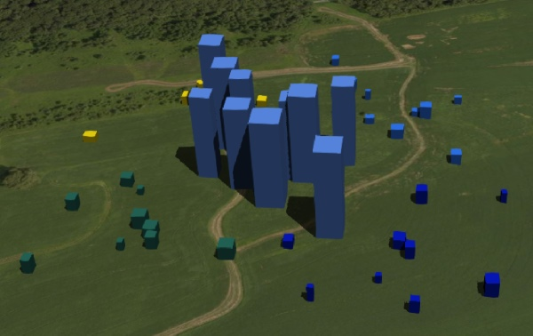
How does refine work?
REPLACE
ADD
Notes:
There are two options in a tileset. With “Replace” the parent disappears and a child takes its place.
With “Add” the children are added on top of the parent.

Slide 27
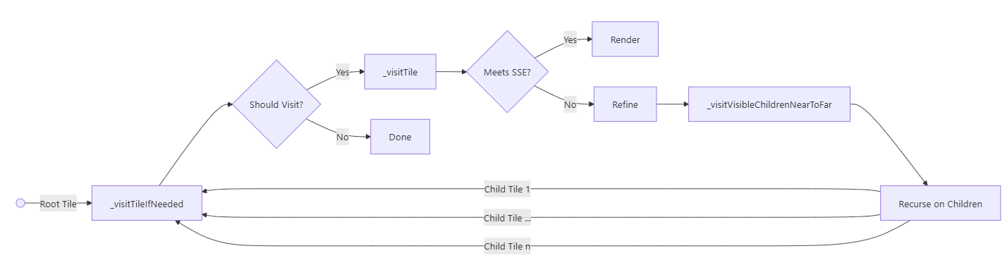
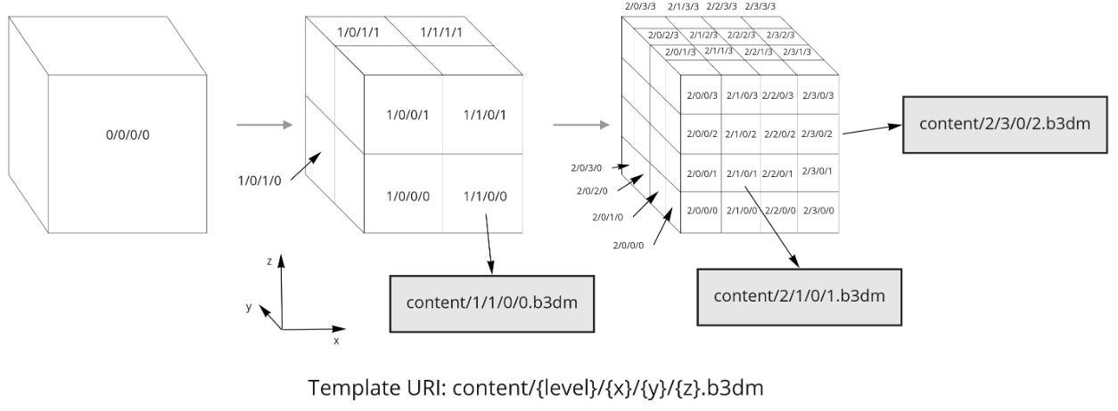
How is the right 3D tile loaded?
content/2/3/0/2.glb
content/1/1/0/0.glb
content/2/1/0/1.glb
Template URI: content/{level}/{x}/{y}/{z}.glb
Notes:
Every tile, starting with the root, enters through this function. It first determines whether the tile needs to be considered at all.
This is test 1 from before: does the tile.boundingVolume intersect the camera frustum (the pyramid from the perspective image)?
This is test 2: calculate the screen space error from the geometricError and the distance to the camera, and compare it with maximumScreenSpaceError.
Refine → _visitVisibleChildrenNearToFar
The children are sorted from near to far and visited in that order. There are two reasons for this:
Load order: what is nearby stands out most and goes to the top of the download queue.
Render efficiency: drawing front to back lets the GPU discard hidden pixels sooner (early depth test).
Recurse on Children → back to _visitTileIfNeeded

Slide 28
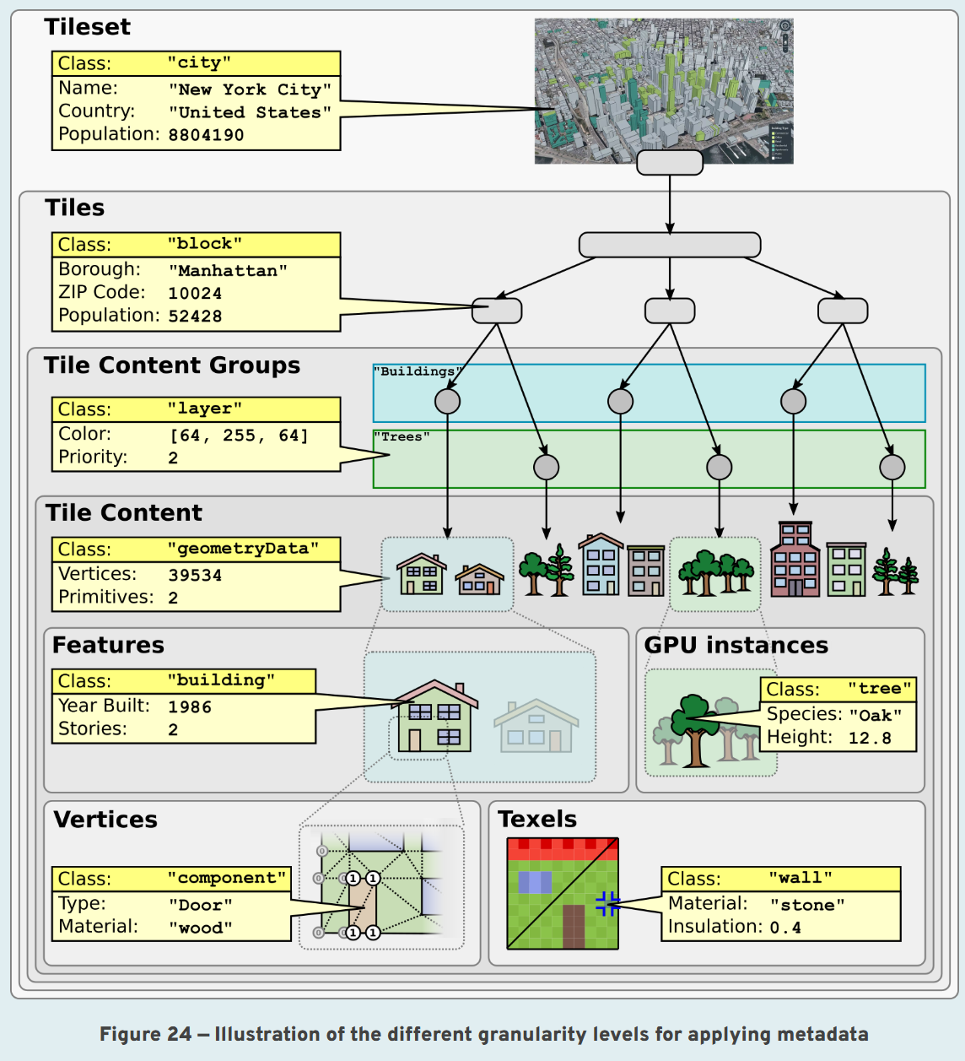
How does metadata work in 3D Tiles?
You can attach properties (attributes) at every level of detail, from the entire dataset down to a single pixel of a texture.
Notes:
Metadata in 1.0
Batch Table: attributes per feature (for example per building) in a table inside the .b3dm, .i3dm or .pnts file. A Feature ID per vertex links the geometry to a row in that table.
properties in tileset.json: only the minimum and maximum value per attribute across the whole tileset, intended for styling.
extras: a free-form field without conventions.
What was missing: a schema (data types, classes, meaning), and metadata at the level of tileset, tile or group. In practice the Batch Table was often untyped JSON.
What 1.1 adds
A schema: classes with typed properties (int, float, string, enum, vector, array, etc.), just like a data model.
Metadata at every level: tileset, tile, content and groups of content. For example, you can record the acquisition year or the source of the data per tile.
Per-feature metadata moves to glTF, via two extensions:
EXT_mesh_features: which vertex or point belongs to which feature (the successor of the Feature ID from the Batch Table);
EXT_structural_metadata: the attribute values themselves, typed and binary, including metadata per texel (property textures), for example material or temperature per pixel of a texture.
Batch Table and b3dm/i3dm/pnts are deprecated in 1.1, but remain valid.

Slide 29
Which version to use?
Generator:
tyler (3DGI) (generates 1.1)
pg2b3dm (generates 1.0 and 1.1)
i3dm.export (generates 1.0 and 1.1; experimental for i3dm)
py3dtiles (Oslandia) (generates 1.0)
Cesium ion (generates 1.0 and 1.1)
FME (unknown)
CityServer3D (unknown)
Viewers:
1.0 (2019, OGC)
      CesiumJS, Cesium for Unity/Unreal
      ArcGIS pro
      QGIS
      FME
      Deck GL
      3D-tiles-rendererJS
1.1 (2022 OGC)
      CesiumJS, Cesium for Unity/Unreal
      ArcGIS (partial)
      QGIS (partial)
      3D-tiles-rendererJS (partial)
2.0 (in development, expected end of 2026)
      Cesium (preview)
Notes:
A rough, non-exhaustive overview. What do you want to do, and in which tool?

Slide 30
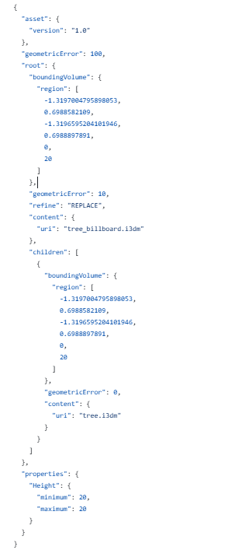



Example 3D Tiles (1.0)
Tree.i3dm
Tree_billboard.i3dm
Source: Cesium 3D Tiles samples
Source: CesiumGS/3d-tiles-samples
Notes:
Where do these examples come from?

Slide 31


Example Tilejson file (1.1)
{
"asset" : {
"version" : "1.1"
},
"schema" : {
"id": "MetadataGranularitiesSchema",
"classes" : {
"exampleTilesetMetadataClass" : {
"name" : "Example tileset metadata class",
"description" : "An example metadata class for a tileset",
"properties" : {
"author" : {
"description" : "The person or entity that made the tileset",
"type" : "STRING“
…
…
},
"exampleGroupMetadataClass" : {
"name" : "Example group metadata class",
"description" : "An example metadata class for tile content groups",
"properties" : {
"color" : {
"description" : "The color with which the group should be rendered",
…
"groups" : [ {
"class" : "exampleGroupMetadataClass",
…
"geometricError" : 1024.0,
"root" : {
"boundingVolume" : {
"box" : [ 0.2524109, 9.536743E-7, 4.5, 16.257824…]
},
"geometricError" : 512.0,
"refine" : "ADD",
"children" : [ {
"boundingVolume" : {
"box" : [ -10.0, 12.988594, 4.0, …. ]
},
"geometricError" : 0.0,
"contents" : [ {
"uri" : "house-3-0.glb",
"metadata" : {
"class" : "exampleContentMetadataClass",
"properties" : {
"vertices" : 1032,
"materials" : 5
}
},
"group" : 0
}, {
"uri" : "tree-spruce-0-0.glb",
"metadata" : {
"class" : "exampleContentMetadataClass",
"properties" : {
"vertices" : 675,
"materials" : 1
…
house_1-1.glb
house_3-0.glb
house_4-2.glb
house_5-3.glb
tree-spruce-0-0.glb
tree-spruce-0-2.glb
tree-spruce-0-3.glb
etc.
Source: CesiumGS/3d-tiles-samples
Notes:
Where do these examples come from?

Slide 32

Hands-on

Slide 33

Geonovum GitHub 3D Tileset(1.0)
Laptop with an internet connection and admin rights
Docker
QGIS 3.40 or higher
Database management tool (pgAdmin or DBeaver)
In this part you use the tools “pg2b3dm” and “i3dm.export” (by Sogelink, formerly GeoDAN) to create 3D Tiles. Conversion of 3D geometry from PostGIS to 3D Tiles.
https://Geonovum.github.io/ogc-api-workshops/3DTiles/2026/
https://github.com/Geonovum/ogc-api-workshops/tree/main/3DTiles/2026

Slide 34

Geonovum GitHub 3D Tileset (1.1)
Laptop with an internet connection and admin rights
Docker
In this part you use the tool “Tyler” to create 3D Tiles.
https://Geonovum.github.io/ogc-api-workshops/3DTiles/2026/
https://github.com/Geonovum/ogc-api-workshops/tree/main/3DTiles/2026

Slide 35

Lunch

Slide 36


Reference: guidelines and standards
https://docs.geostandaarden.nl/3d/ld-hr-3d-tiling-20250113/
https://docs.ogc.org/cs/22-025r4/22-025r4.html

Slide 37



Reference: websites
https://3dtilesnederland.nl/3d-tiles/
https://sandcastle.cesium.com/
https://github.com/CesiumGS/3d-tiles-samples

Slide 38
Thank you!

